Slide 1
Convolutions

Slide 2
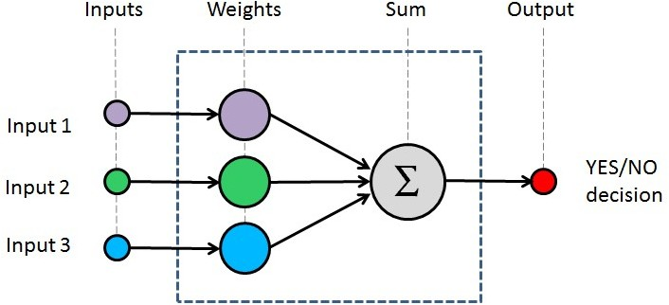
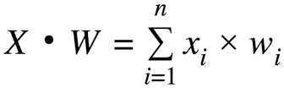
What is convolution?
= w^{T}x

Slide 3
What is convolution?
Out = 0
for index in number_of_inputs:
Out = Out + (input[index] x weight[index])

Slide 4
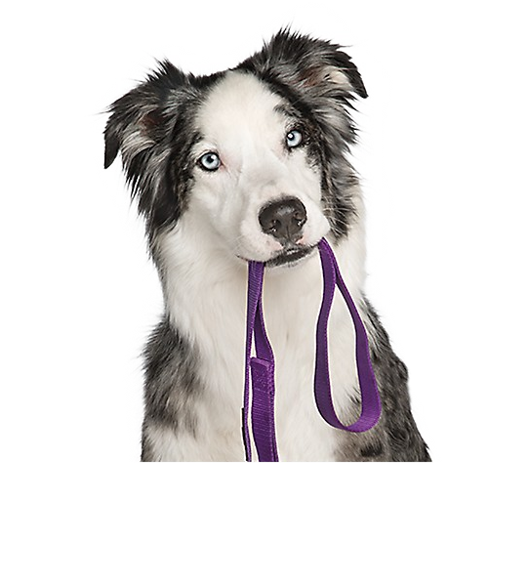

What is convolution?

Slide 5
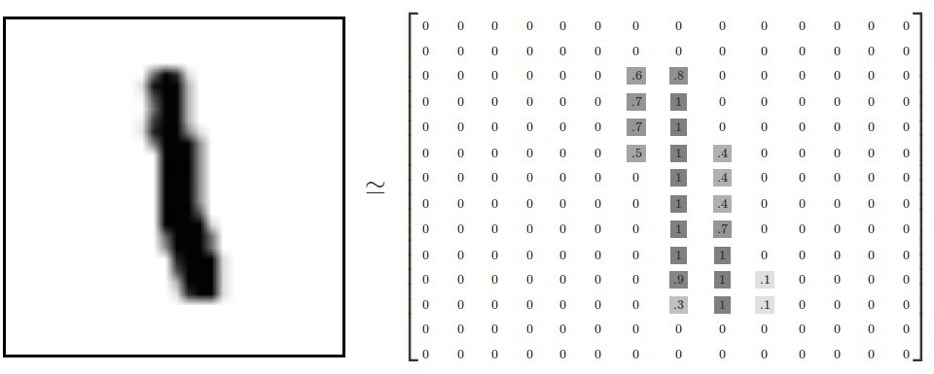
What is convolution?

Slide 6
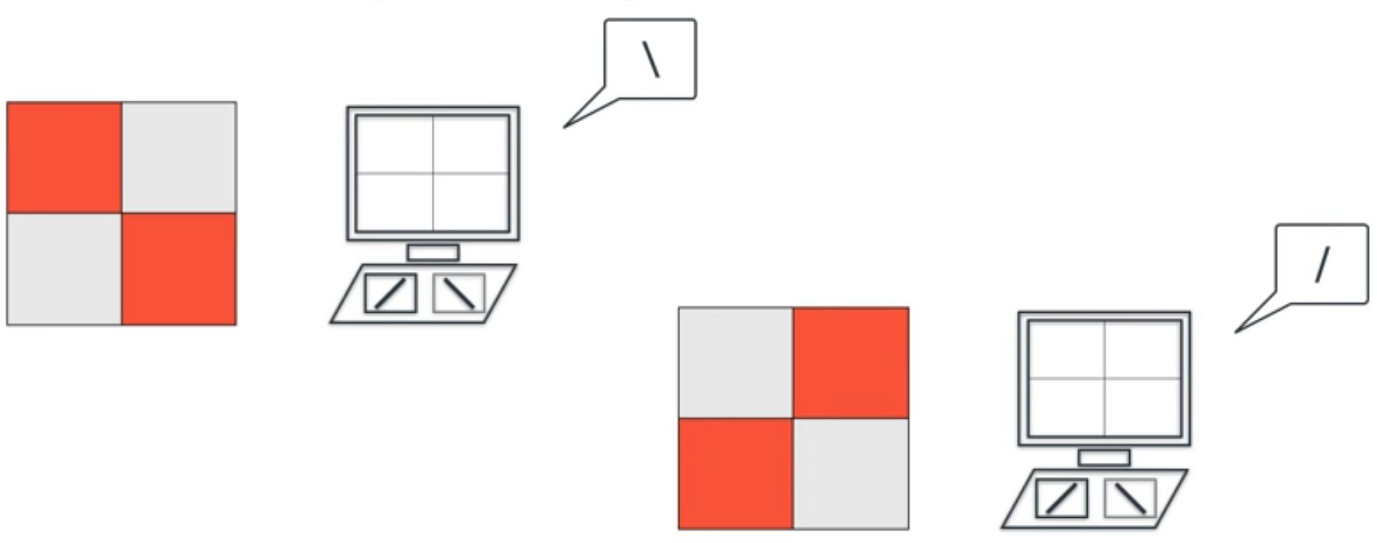
What is convolution? Detecting slash or backslash..
SOURCE: Luis Serrano, Udacity, https://www.youtube.com/watch?v=2-Ol7ZB0MmU

Slide 7
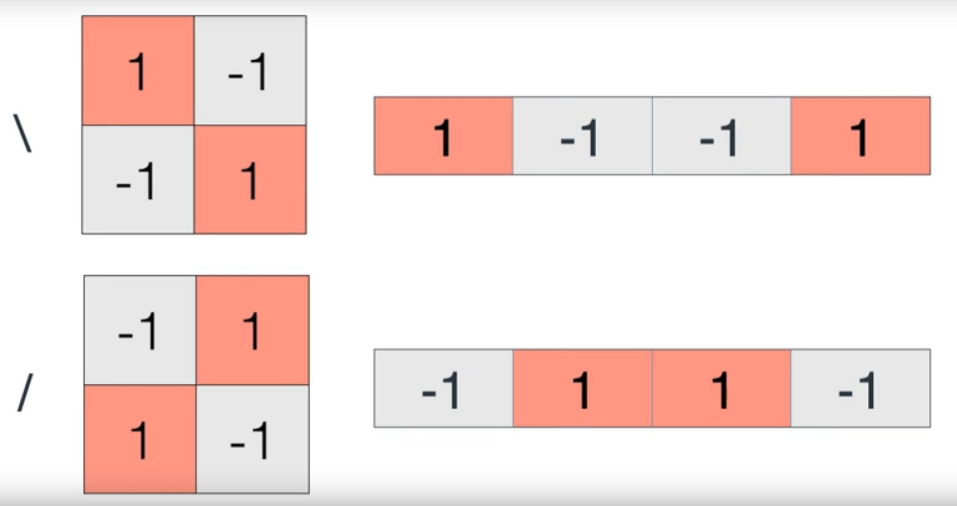
What is convolution?
SOURCE: Luis Serrano, Udacity, https://www.youtube.com/watch?v=2-Ol7ZB0MmU

Slide 8
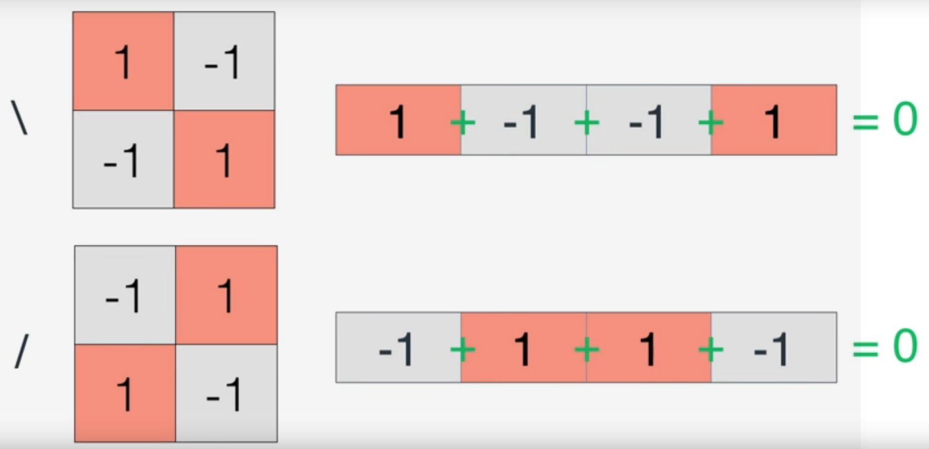
What is convolution?
SOURCE: Luis Serrano, Udacity, https://www.youtube.com/watch?v=2-Ol7ZB0MmU

Slide 9
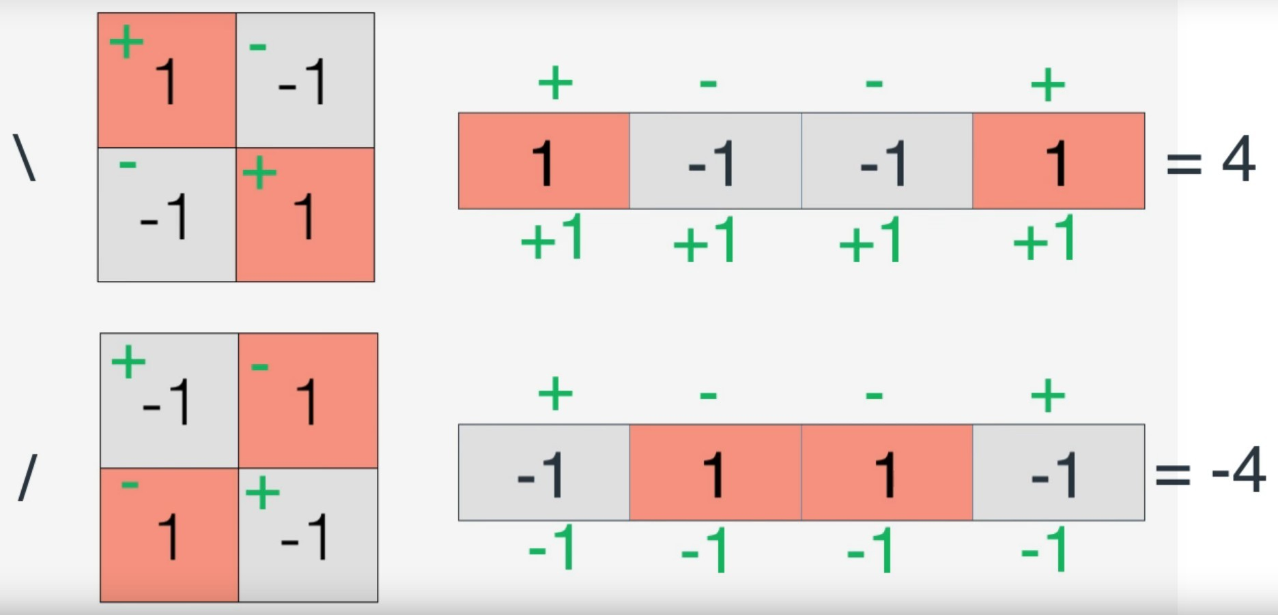
What is convolution?
SOURCE: Luis Serrano, Udacity, https://www.youtube.com/watch?v=2-Ol7ZB0MmU

Slide 10
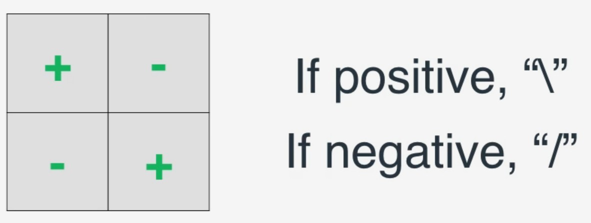
What is convolution?
Convolutional Kernel
Image Classifier
SOURCE: Luis Serrano, Udacity, https://www.youtube.com/watch?v=2-Ol7ZB0MmU

Slide 11
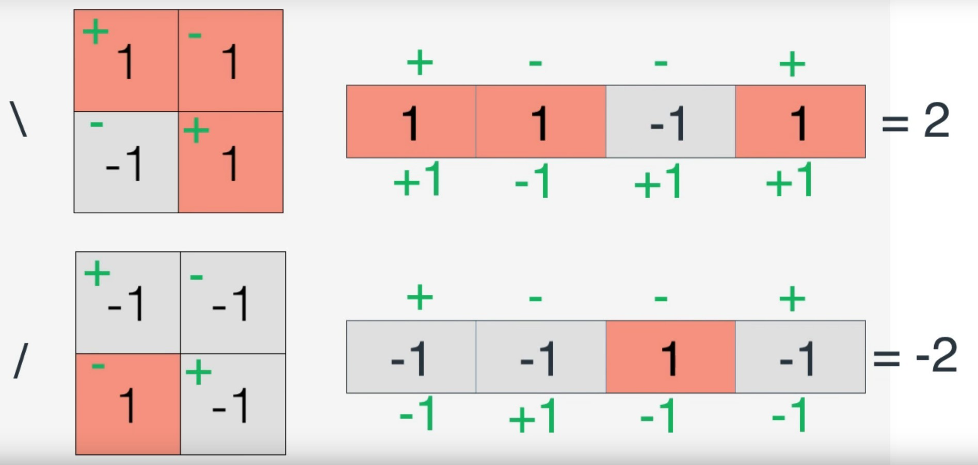
What is convolution?
SOURCE: Luis Serrano, Udacity, https://www.youtube.com/watch?v=2-Ol7ZB0MmU

Slide 12
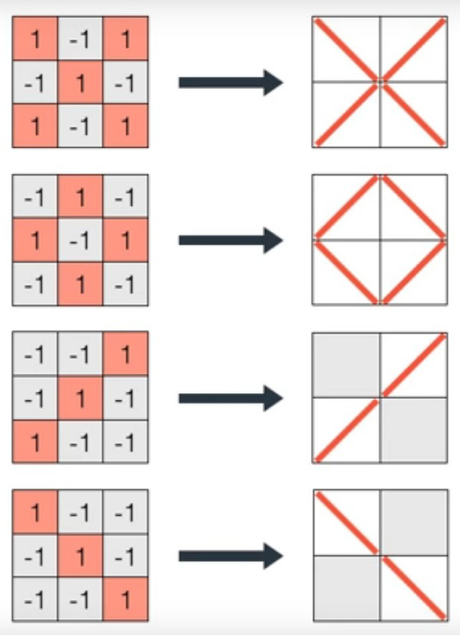
What is convolution?
SOURCE: Luis Serrano, Udacity, https://www.youtube.com/watch?v=2-Ol7ZB0MmU

Slide 13
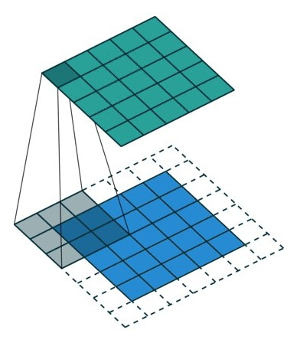
What is convolution?
Feature Map
Kernel or Filter Image
Source: Vincent Dumoulin, https://github.com/vdumoulin/conv_arithmetic

Slide 14
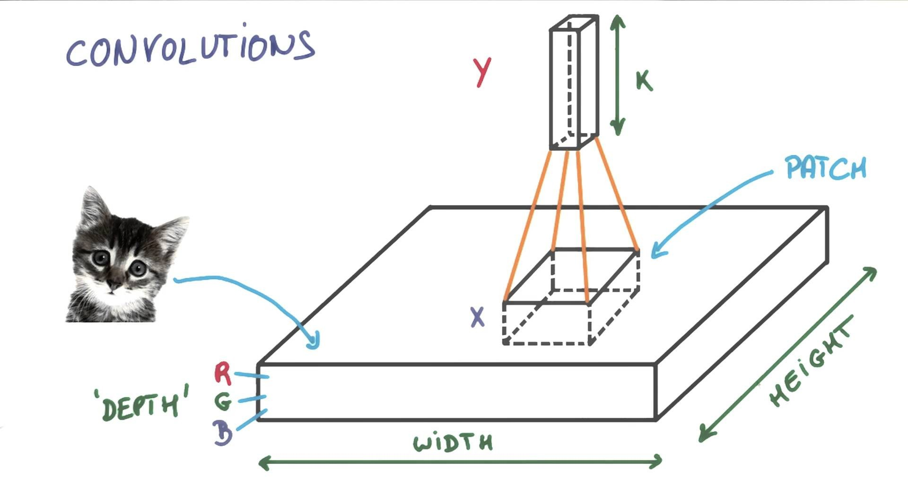
What is convolution?
Source: Vincent Vanhoucke, Udacity, https://www.youtube.com/watch?v=jajksuQW4mc

Slide 15
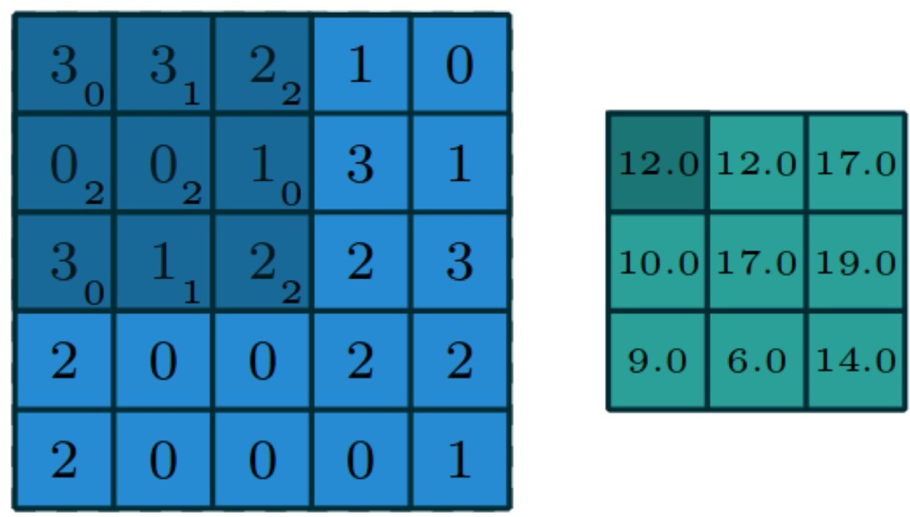
What is convolution?
Image
Feature Map
Source: Vincent Dumoulin and Francesco Visin, https://arxiv.org/pdf/1603.07285.pdf

Slide 16
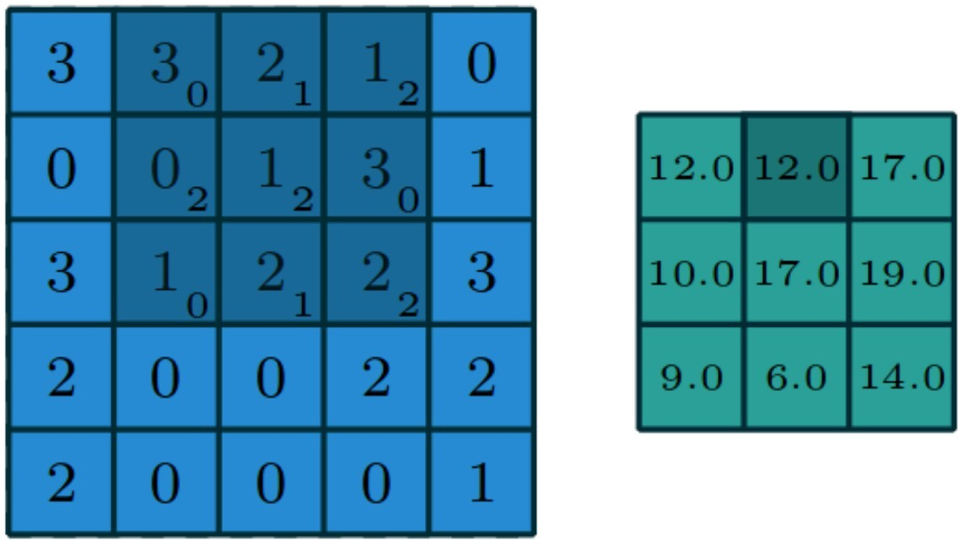
Image
Feature Map
Source: Vincent Dumoulin and Francesco Visin, https://arxiv.org/pdf/1603.07285.pdf

Slide 17
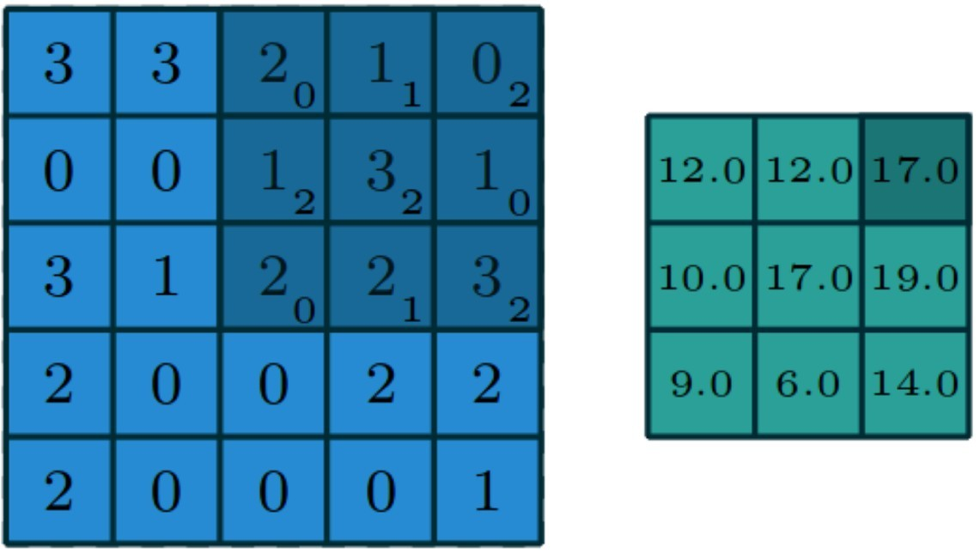
Image
Feature Map
Source: Vincent Dumoulin and Francesco Visin, https://arxiv.org/pdf/1603.07285.pdf

Slide 18
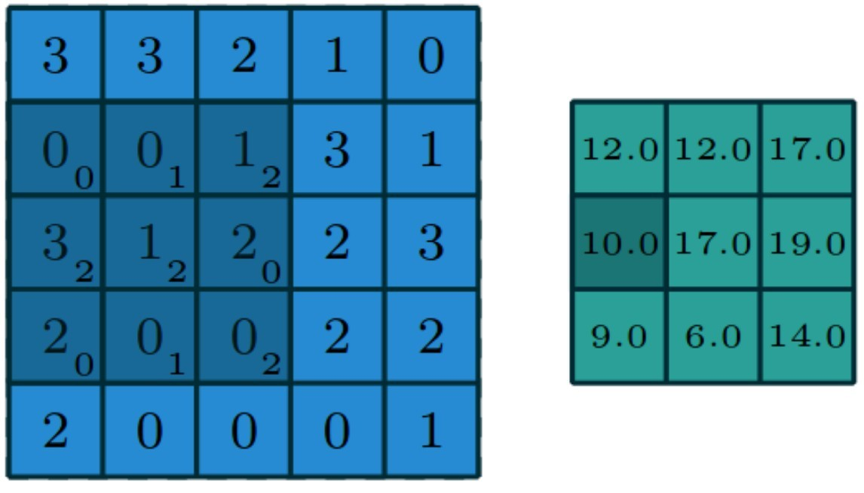
Image
Feature Map
Source: Vincent Dumoulin and Francesco Visin, https://arxiv.org/pdf/1603.07285.pdf

Slide 19
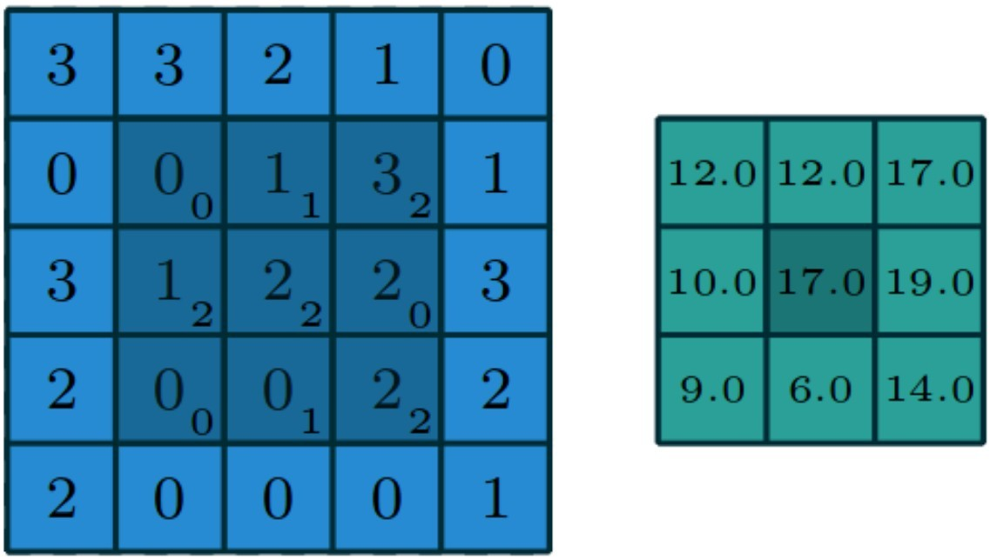
Image
Feature Map
Source: Vincent Dumoulin and Francesco Visin, https://arxiv.org/pdf/1603.07285.pdf

Slide 20
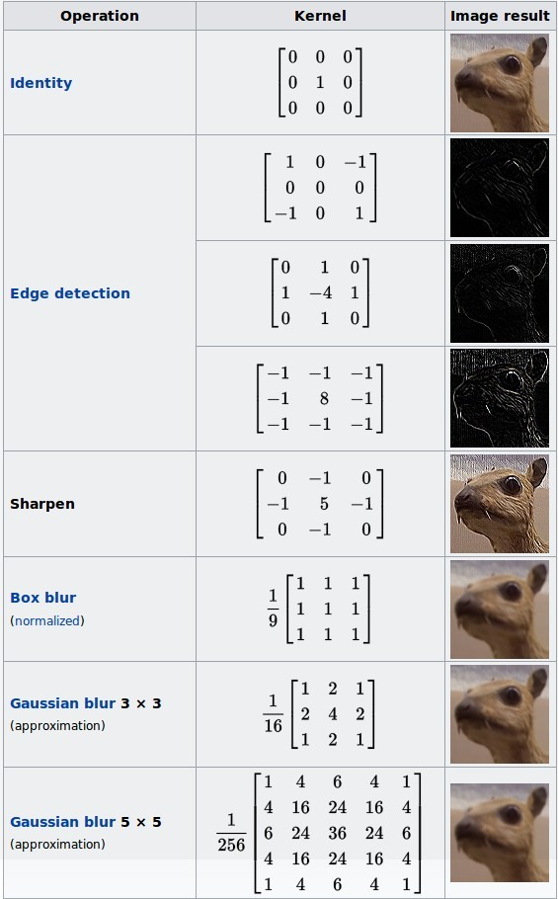
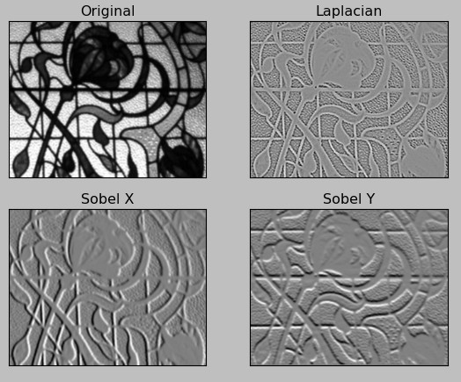
Watch the video: http://setosa.io/ev/image-kernels/

Slide 21
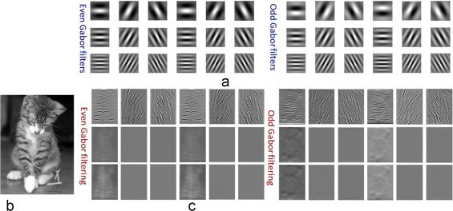
What is convolution? Gabor Filter
Source: http://www.sciencedirect.com/science/article/pii/S0031320315001570

Slide 22
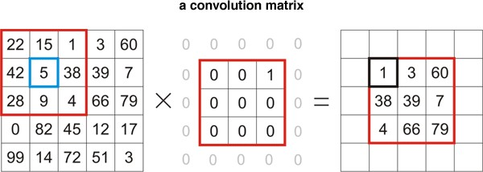
What is convolution?
“Take the top right corner of the image?”

Slide 23
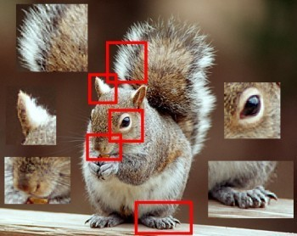
What is convolution?
Convolution creates FEATURE DETECTORS.

Slide 24
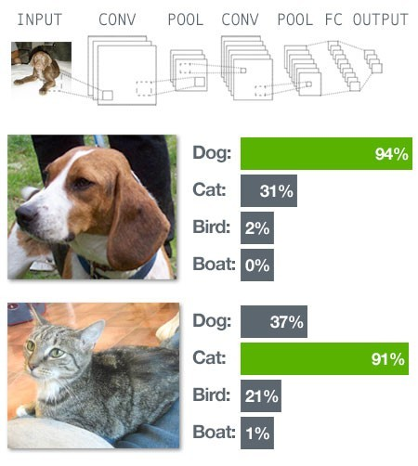
Convolutional Networks

Slide 25
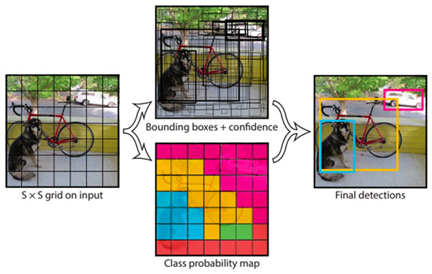
YOLO

Slide 26
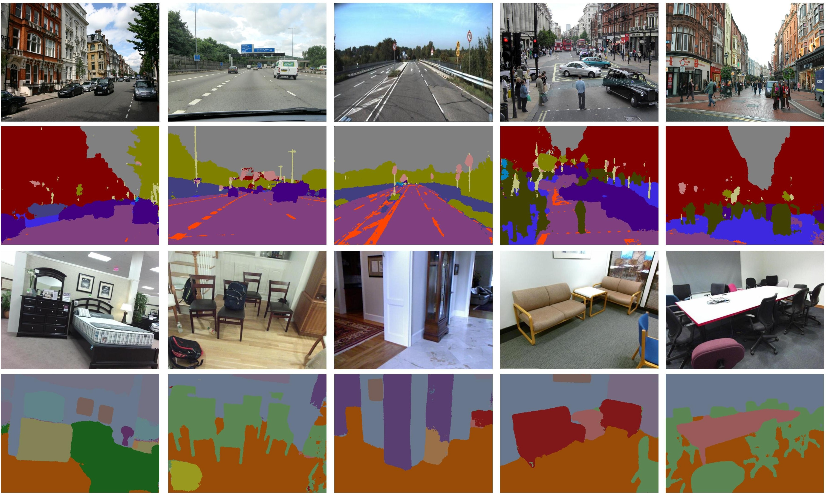
SegNet
University of Cambridge, https://www.youtube.com/watch?v=CxanE_W46ts

Slide 27
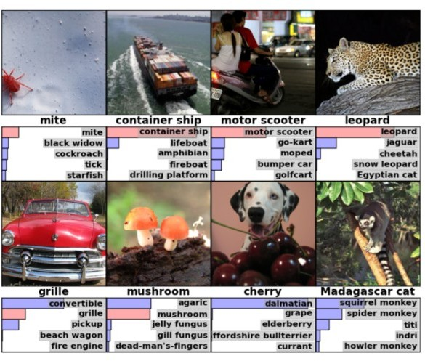
ImageNet
Source: https://papers.nips.cc/paper/4824-imagenet-classification-with-deep-convolutional-neural-networks

